Slide 1
Disaster Hits pisaster
Understanding Sea star wasting disease
Muhammad kala
Kirsten tyler

Slide 2
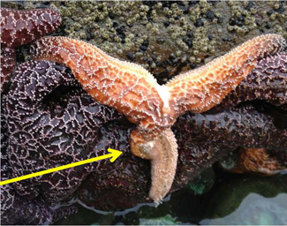
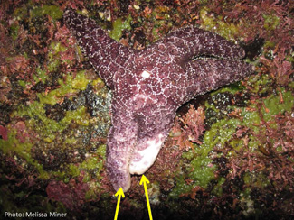
introduction
Sea Star Wasting Disease
Millions of individuals in at least 20 species (Asteroidea) have perished
Cause still unknown
Focus on Pisaster ochraceus in CA
Keystone species
Photos by Melissa Miner, USCS
Notes:
SSWD: has fast onset. Symptoms include lesions, loss of turgor pressure, then limbs pulling off from moving, ending in organs spilling out of wounds, and DEATH. Mortality rate 50-100%.
1970s large outbreak but not as extreme as the most recent outbreak in
Pisaster ochraceus, generally known as the purple sea star, ochre sea star, or ochre starfish, is a common starfish found among the waters of the Pacific Ocean. Identified as a keystone species, Pisaster is considered an important indicator for the health of the intertidal zone.

Slide 3

Objectives
Is there a genetic basis for resistance to SSWD in sea stars?
What roles (if any) does the microbiome play in susceptibility or resistance of sea stars to the pathogen?

Slide 4
Objectives
Is there a genetic basis for resistance to SSWD in sea stars?
Hypothesis 1: sea stars free of the disease are potentially resistant through genetic means such as having more suitable alleles of immune response genes

Slide 5
Objectives
What roles (if any) does the microbiome play in susceptibility or resistance of sea stars to the pathogen?
Hypothesis 2: an individual’s microbiome does play a role in the onset and progression of SSWD

Slide 6
Experimental design
24 healthy individuals were collected from intertidal and subtidal sites of Monterey, CA
Shipped to lab and placed into individual tanks
Reared for 15 days in tanks
Every 3 days, epidermal tissue was biopsied and health status and symptoms were recorded
RNA & 16S extracted from tissue samples for analysis

Slide 7
Methods: Pipeline
biopsied epidermal tissue
extract RNA
SNPs called from reads
reads2snps
SNPs filtered
reads sequenced & mRNA library built
reads cleaned and evaluated
Illumina
VCFtools
DAPC analysis
adegenet in R
Transcriptome assembled & evaluated
TransDecoder
FastQC & Trimomatic
cleaned reads mapped to transcriptome
predict ORFs
SAM file
biopsied epidermal tissue
extract 16S
map reads
using?
call SNPs
reads2snps
filter SNPs
16S amplified & sequenced
OUT table
using?
Program?
VCFtools
run DAPC analysis
adegenet in R

Slide 8
Methods: Discriminant Analysis of Principal Components
1. Cleaned raw SNP data to analyze
used VCFTools to subset intertidal individuals
used VCFTools to filter the file (min/max 2; maf 0.02; max-miss 0.8)
2. Loaded VCF SNP data into R for analysis
used adegenet to create genlight object from VCF file for efficient analysis
loaded and organized metadata to match my VCF file
3. Ran DAPC analysis using disease status to group samples (HH, HS, SS in the intertidal) & identify significant loci
number of axes retained in PCA step (n.pca) = 8
number of axes retained in the DA step (n.da) = 2
4. Used annotation table to identify significant genes
assembly annotated on server using BLAST+
used grep and paste in Terminal to pull out only 11 significant loci in annotation table
5. Researched gene ontology in NCBI
Notes:
Is there genetic basis? To explore this question, we used DAPC analysis to distinguish and cluster genetically related individuals based on pre-defined groups (our groups being HH, HS/SS and intertidal, subtidal.
To control for any genetic differences between locations, first we’ll focus on differences and similarities between healthy and sick individuals (using ”trajectory”) in the intertidal location.
Then we’ll take one more step to compare trajectory status between locations.
----something like: when differences are found, we’ll delve deeper into what those differences might be using…..BLAST??

Slide 9
Methods: Discriminant Analysis of Principal Components
1. Filtered raw SNP data to analyze
used VCFTools to subset intertidal individuals
used VCFTools to filter the file (min/max 2; maf 0.02; max-miss 0.8)
2. Loaded VCF SNP data into R for analysis
used adegenet to create genlight object from VCF file for efficient analysis
loaded and organized metadata to match my VCF file
3. Ran DAPC analysis using disease status to group samples (HH, HS, SS in the intertidal)
number of axes retained in PCA step (n.pca) = 8
number of axes retained in the DA step (n.da) = 2
4. Made annotation table in Termnal with significant loci
used grep and paste
5. Researched gene ontology in NCBI
Notes:
Is there genetic basis? To explore this question, we used DAPC analysis to distinguish and cluster genetically related individuals based on pre-defined groups (our groups being HH, HS/SS and intertidal, subtidal.
To control for any genetic differences between locations, first we’ll focus on differences and similarities between healthy and sick individuals (using ”trajectory”) in the intertidal location.
Then we’ll take one more step to compare trajectory status between locations.
----something like: when differences are found, we’ll delve deeper into what those differences might be using…..BLAST??

Slide 10
Methods: Discriminant Analysis of Principal Components
1. Cleaned raw data to analyze
used VCFTools to subset intertidal individuals
used VCFTools to filter the file (min/max 2; maf 0.02; max-miss 0.8)
2. Loaded VCF SNP data into R for analysis
used adegenet to create genlight object from VCF file for efficient analysis
loaded and organized metadata to match my VCF file
3. Ran DAPC analysis using disease status to group samples (HH, HS, SS in the intertidal)
number of axes retained in PCA step (n.pca) = 8
number of axes retained in the DA step (n.da) = 2
4. Made annotation table in Termnal with significant loci
used grep and paste
5. Researched gene ontology in NCBI
Notes:
Is there genetic basis? To explore this question, we used DAPC analysis to distinguish and cluster genetically related individuals based on pre-defined groups (our groups being HH, HS/SS and intertidal, subtidal.
To control for any genetic differences between locations, first we’ll focus on differences and similarities between healthy and sick individuals (using ”trajectory”) in the intertidal location.
Then we’ll take one more step to compare trajectory status between locations.
----something like: when differences are found, we’ll delve deeper into what those differences might be using…..BLAST??

Slide 11
Methods: Discriminant Analysis of Principal Components
1. Cleaned raw data to analyze
used VCFTools to subset intertidal individuals
used VCFTools to filter the file (min/max 2; maf 0.02; max-miss 0.8)
3. Ran DAPC analysis using disease status to group samples in the intertidal
no. of axes retained in PCA step (n.pca) = 8
no. of axes retained in the DA step (n.da) = 2
2. Loaded VCF SNP data into R for analysis
used adegenet to create genlight object from VCF file for efficient analysis
loaded and organized metadata to match my VCF file
4. Made annotation table in Termnal with significant loci
used grep and paste
5. Researched gene ontology in NCBI
Notes:
Is there genetic basis? To explore this question, we used DAPC analysis to distinguish and cluster genetically related individuals based on pre-defined groups (our groups being HH, HS/SS and intertidal, subtidal.
To control for any genetic differences between locations, first we’ll focus on differences and similarities between healthy and sick individuals (using ”trajectory”) in the intertidal location.
Then we’ll take one more step to compare trajectory status between locations.
----something like: when differences are found, we’ll delve deeper into what those differences might be using…..BLAST??

Slide 12
Methods: Discriminant Analysis of Principal Components
1. Cleaned raw SNP data to analyze
used VCFTools to subset intertidal individuals
used VCFTools to filter the file (min/max 2; maf 0.02; max-miss 0.8)
2. Loaded VCF SNP data into R for analysis
used adegenet to create genlight object from VCF file for efficient analysis
loaded and organized metadata to match my VCF file
4. Used annotation table to identify significant genes
assembly annotated on server using BLAST+
used grep and paste in Terminal to pull out only 11 significant loci in annotation table
3. Ran DAPC analysis using disease status to group samples (HH, HS, SS in the intertidal)
number of axes retained in PCA step (n.pca) = 8
number of axes retained in the DA step (n.da) = 2
5. Researched gene ontology in NCBI
Notes:
Is there genetic basis? To explore this question, we used DAPC analysis to distinguish and cluster genetically related individuals based on pre-defined groups (our groups being HH, HS/SS and intertidal, subtidal.
To control for any genetic differences between locations, first we’ll focus on differences and similarities between healthy and sick individuals (using ”trajectory”) in the intertidal location.
Then we’ll take one more step to compare trajectory status between locations.
----something like: when differences are found, we’ll delve deeper into what those differences might be using…..BLAST??

Slide 13
Methods: Discriminant Analysis of Principal Components
1. Cleaned raw SNP data to analyze
used VCFTools to subset intertidal individuals
used VCFTools to filter the file (min/max 2; maf 0.02; max-miss 0.8)
2. Loaded VCF SNP data into R for analysis
used adegenet to create genlight object from VCF file for efficient analysis
loaded and organized metadata to match my VCF file
5. Researched gene ontology in NCBI
Gene database
3. Ran DAPC analysis using disease status to group samples (HH, HS, SS in the intertidal)
number of axes retained in PCA step (n.pca) = 8
number of axes retained in the DA step (n.da) = 2
4. Made annotation table in Termnal with significant loci
used grep and paste
Notes:
Is there genetic basis? To explore this question, we used DAPC analysis to distinguish and cluster genetically related individuals based on pre-defined groups (our groups being HH, HS/SS and intertidal, subtidal.
To control for any genetic differences between locations, first we’ll focus on differences and similarities between healthy and sick individuals (using ”trajectory”) in the intertidal location.
Then we’ll take one more step to compare trajectory status between locations.
----something like: when differences are found, we’ll delve deeper into what those differences might be using…..BLAST??

Slide 14
methods
What roles (if any) do the microbiome play in susceptibility or resistance of sea stars to the pathogen?
Analysis
Comparisons
Comparisons
Further analysis
Notes:
Is there genetic basis? To explore this question, we’ll use DAPC analysis to distinguish and cluster genetically related individuals based on pre-defined groups (our groups being HH, HS/SS and intertidal, subtidal.
To control for any genetic differences between locations, first we’ll focus on differences and similarities between healthy and sick individuals (using ”trajectory”) in the intertidal location.
Then we’ll take one more step to compare trajectory status between locations.
----something like: when differences are found, we’ll delve deeper into what those differences might be using…..BLAST??

Slide 15
results
We found some cool shit.
Let us tell you about it.

Slide 16
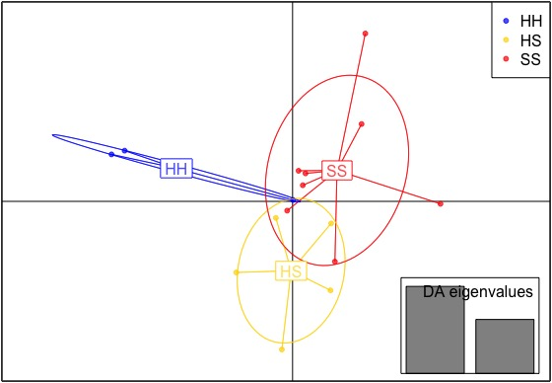
Results: DAPC
DAPC Scatterplot
DAPC analysis shows separation between groups
8.13 5.02
Notes:
DAPC analysis maximized variation between groups while minimizing variation within groups

Slide 17
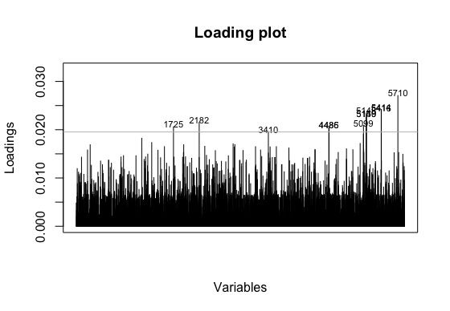
Results: DaPC
11 loci contribute the most to distinguishing HH, HS, and SS in the intertidal location
probs = 0.999

Slide 18
Results: gene ontology
DNA binding
DNA regulation
protein ubiquitination
integral component of membrane
stress response

Slide 19
Discussion
Two of the genes might be involved in immune processes in the CNS
Implications for resistance to SSWD
Finding mechanisms of these genes would be helpful
6 of 11 genes were not annotated that might be of interest

Slide 20
Discussion

Slide 21
Future directions
Perform DAPC analysis in different populations to see if the same genes are identified
Sampling populations over time to assess selection on the significant SNPs in this study
6 out of 11 genes were unrecognized. Let’s find out more about them.

Slide 22
Questions?

